Slide 1
Report on the participation in the doctoral summer school at the Berlin University of Technology 3 – 7 August 2015 on the project TEMPUS – NETCENG
Participants from
National Technical University of Ukraine "KPI":
Khominych Oleh and Oleinik Evgen
Berlin – 2015

Slide 2
Training Course Program
1 | Arrival of the participants | 02.08.2015
2 | Introduction to the Doctoral Summer School. Opening keynotes Presentation of the study program, introduction to the course subject. Personal motivation. Presentation skills. Requirements for successful PhD completion. Generating new Research Ideas. Research planning – how to plan potential scientific research. | 03.08.2015
3 | Quality assurance – criteria and methods for assesment of scientific works and papers. Review of one high level published works. Review of own abstracts => oral resentation or posters. How to write a successful scientific article. Guided Tour in Berlin. | 04.08.2015
4 | Secrets of giving a good scientific talk. How to prepare a poster for the conference. How to present at the scientific conference. Consultation on preparation of posters, papers and presentations for the Doctoral excibition. Demystifying the Writing and Publishing Process | 05.08.2015
5 | Individual research work, preparation of posters and presentations. Consultations if requested | 06.08.2015
6 | Poster presentations - PhD students and their supervisors, experts to review the posters. Excebition of posters and presentation. Final results of the expert jury. | 07.08.2015
7 | Departure of the participants | 08.08.2015

Slide 3
Universities – participants of the doctoral summer school
Belarus
- Belarusian National Technical University;
- Belarusian State University;
- Polotsk State University.
Russia
- Kazan National Research Technical University;
- Omsk State Technical University;
- Ryazan State Radio Engineering University;
- Far Eastern Federal University;
- Ural Federal University.
Ukraine
- Cherkassy State Technological University;
- National Aviation University;
National Technical University of Ukraine “KPI”.
European Union
- Brunel University;
TU Berlin University;
Vilnius Gediminas Technical University (VGTU).

Slide 4
2. The presentation of lectures and workshops on the preparation of projects for participation in the contest was conducted from 03.08.2015 on 05.08.2015
1. Opening of the Summer School 03.08.2015
With the report on the Berlin Technical University and the tasks of the doctoral summer school year was made by prof. Arnold Sternharz
With the reports according to the plans made by the doctoral summer school:
from Brunel University (London) – Doc. Tatiana Kalganova
from Vilnius Gediminas Technical University (VGTU) – Doc. Jelena Stankevičien

Slide 5
The main scientometric database
Scopus is a bibliographic database containing abstracts and citations for academic journal articles. It covers nearly 22,000 titles from over 5,000 publishers, of which 20,000 are peer-reviewed journals in the scientific, technical, medical, and social sciences (including arts and humanities). It is owned by Elsevier and is available online by subscription. Searches in Scopus also incorporate searches of patent databases.
Index Copernicus (IC) is an online database of user-contributed information, including scientist profiles, as well as of scientific institutions, publications and projects established in 1999 in Poland. The database has several productivity assessment tools to track the impact of scientific works and publications, individual scientists, or research institutions. In addition to the productivity aspects, IC also offers the traditional abstracting and indexing of scientific publications. The database is operated by Index Copernicus International.
Web of Science (previously known as (ISI) Web of Knowledge) is an online subscription-based scientific citation indexing service maintained by Thomson Reuters that provides a comprehensive citation search. It gives access to multiple databases that reference cross-disciplinary research, which allows for in-depth exploration of specialized sub-fields within an academic or scientific discipline.

Slide 6
Collections of scientific articles published in NTU "KPI" for aviation
Mechanics gyroscopic systems
Founded: 1982
Topics: lighting of dynamic processes in gyroscopic and other facility management systems, their conditions stabilize at various destabilizing factors excitation, information systems, systems and aids to navigation, measurement and processing of the information in these systems.
ISSN: 0203-3771
Certificate of state registration: square number 15068-3640 p from 06.04.2009
Frequency: 2 times a year
Language of edition: Ukrainian, English, Russian
Founder: National Technical University of Ukraine "Kyiv Polytechnic Institute". Department of aviation and space systems
Editor in Chief: Zbrutskyi Alexander, doc., prof.
Indexing: index copernicus international
Impact factor icv 2014: 45,59

Slide 7
Information systems, mechanics and management
Founded: 2008
Topics: coverage of issues in the field of systems and devices measuring objects and movement, processing and transmission of information, systems and objects mowing controls
ISSN: 2219-3804
Certificate of state registration: KV number 13992-2962R on 14.04.2008
Frequency: 2 times a year
Language of publication: Russian, Ukrainian, English
Founder: National Technical University of Ukraine "Kyiv Polytechnic Institute"
Editor in Chief: Zbrutskyi Alexander, doc., prof.
Indexing: Index Copernicus International
Impact Factor ICV 2014: 50,96

Slide 8
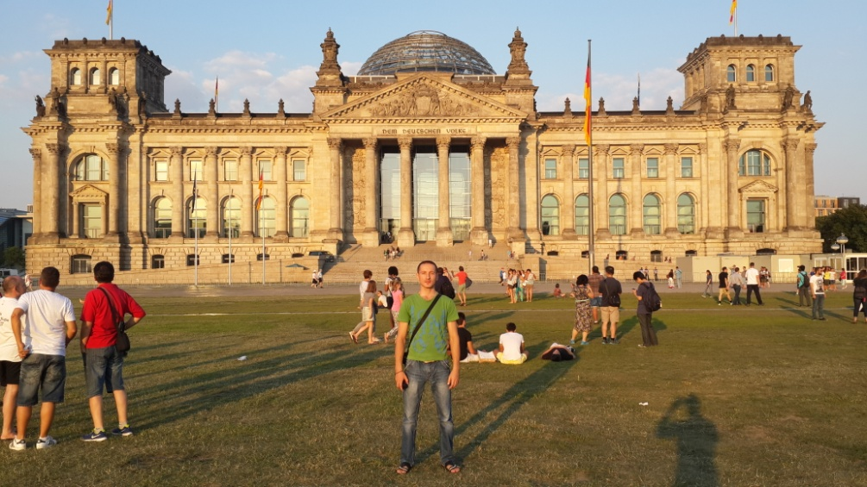
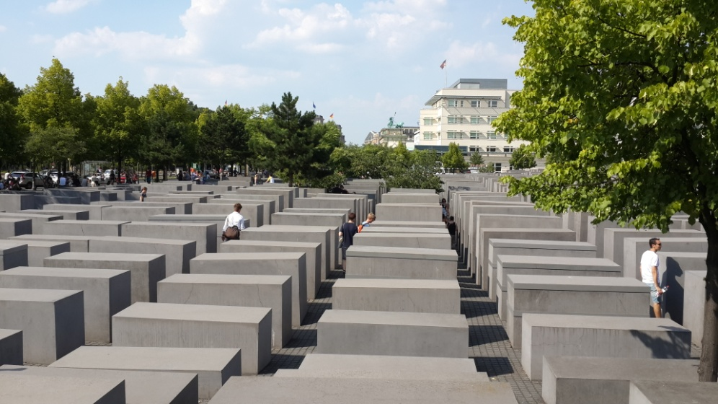
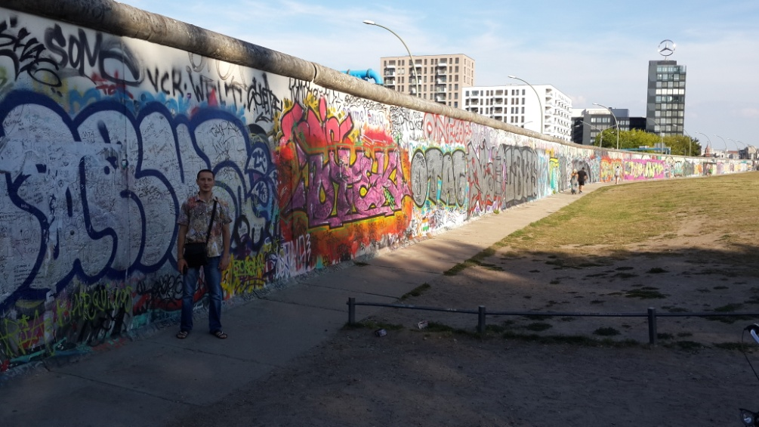
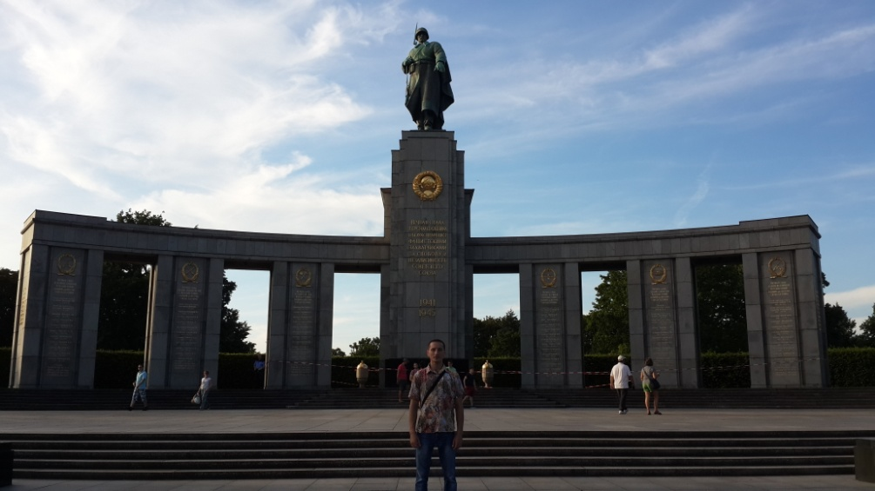
Tour in Berlin.
Reichstag
Monument to the Murdered Jews
Berlin Wall
Monument to Soviet soldiers
Berlin liberators

Slide 9
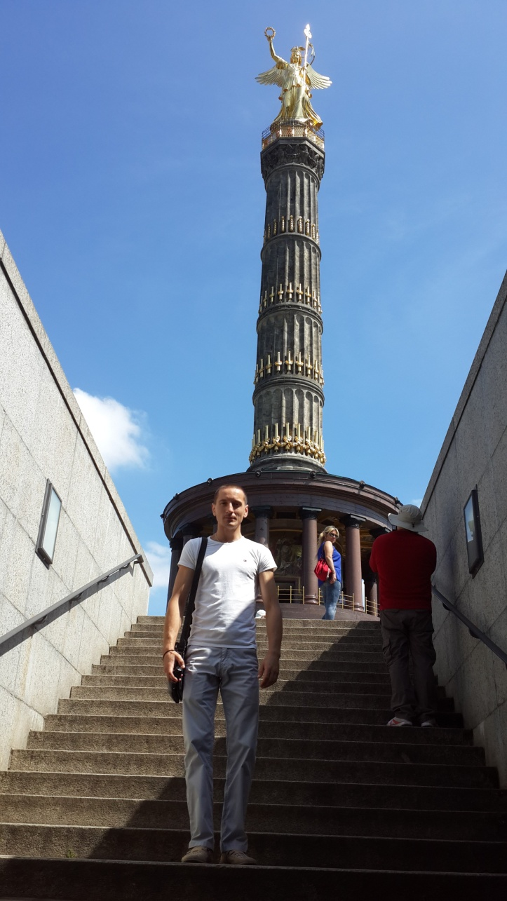
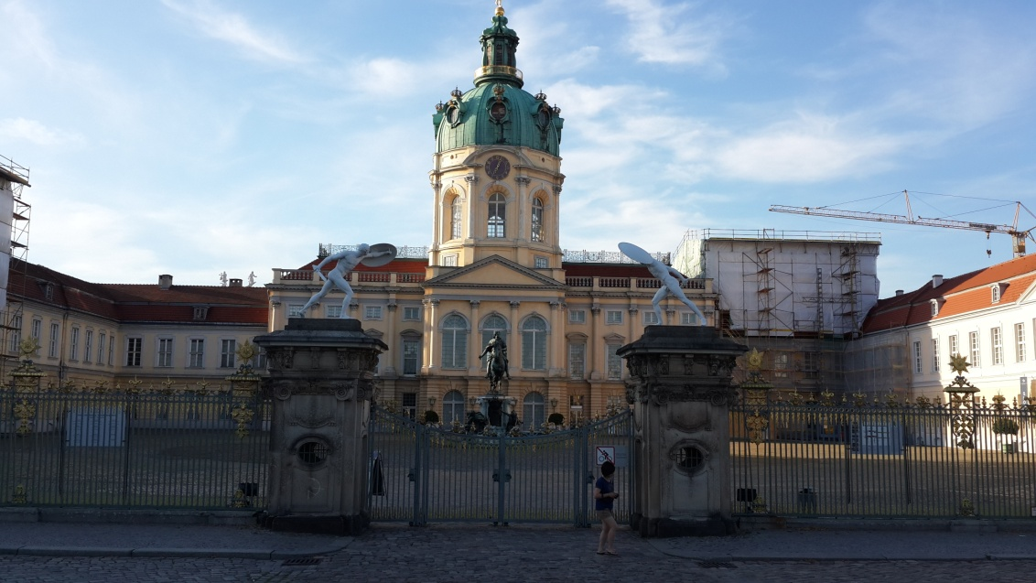
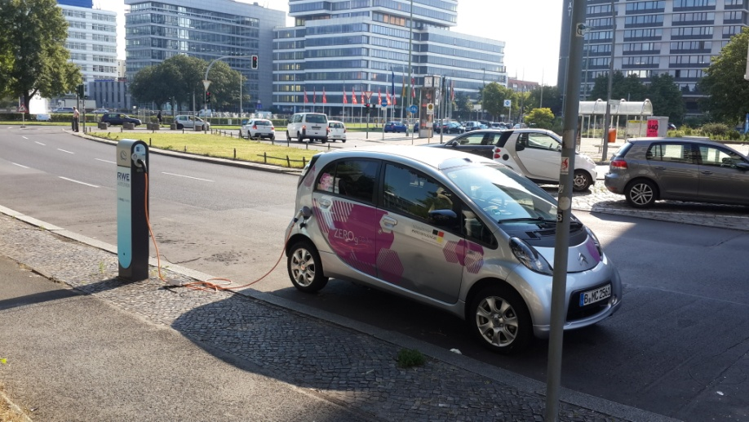
Tour in Berlin
Charlottenburg Palace
Charging electric vehicle
Victory Column

Slide 10
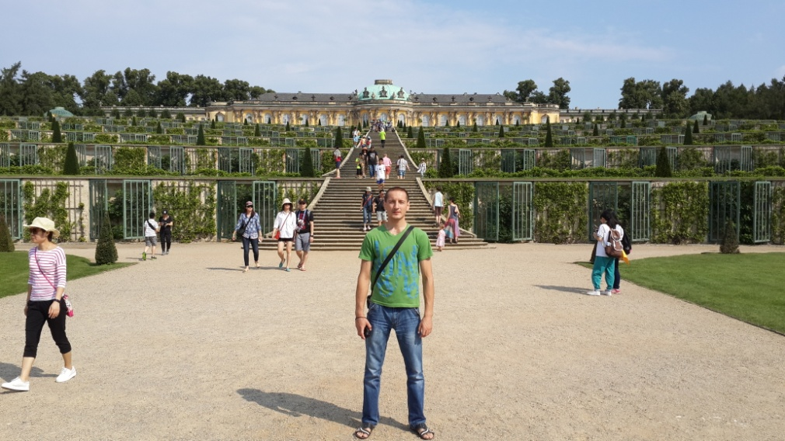
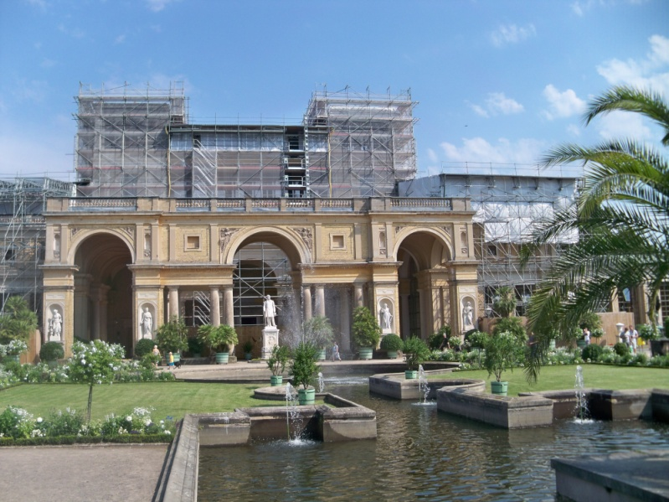
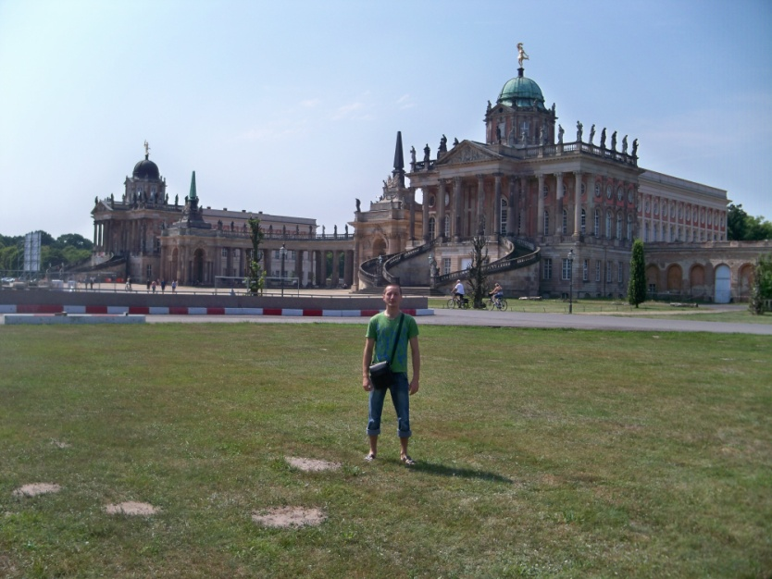
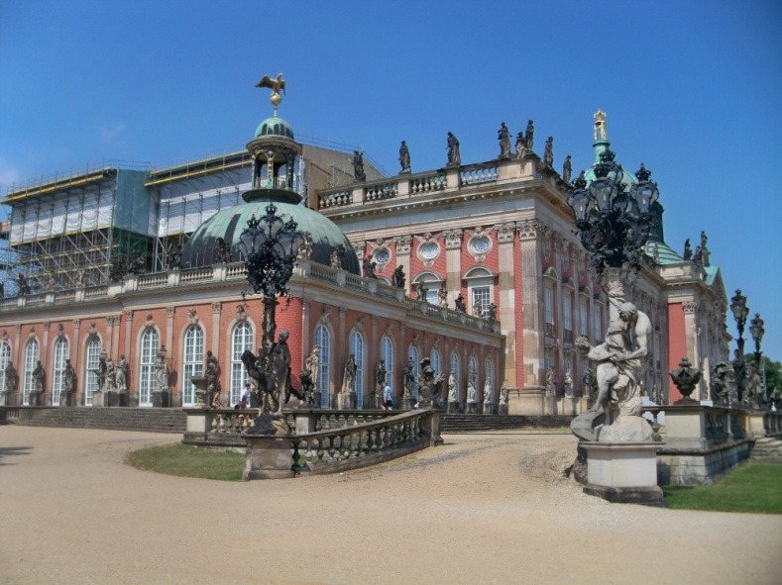
Excursion to Potsdam
Palace Sanssouci
Orangery Palace
The new palace of Frederick the Great
The baroque new palace

Slide 11
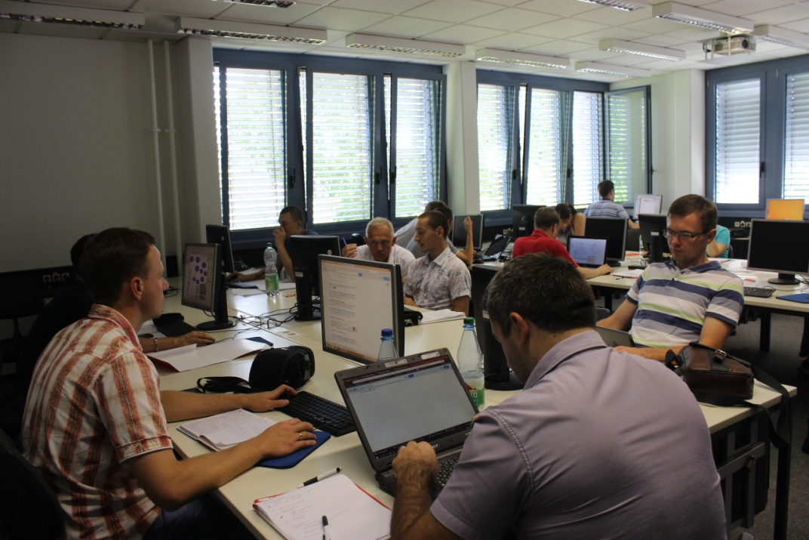
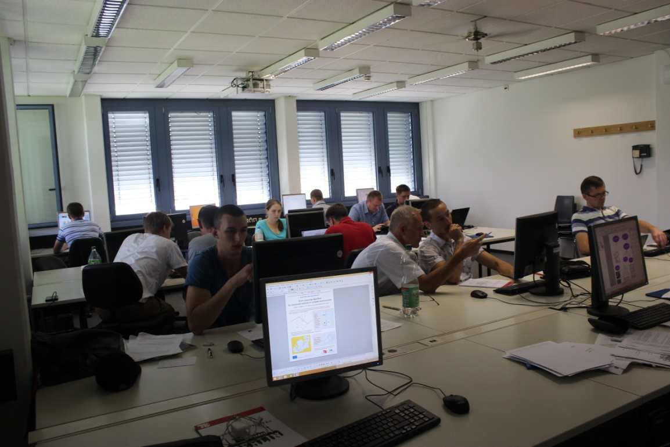
Preparing posters
During individual work, participants prepared posters for performances in the doctoral school.

Slide 12
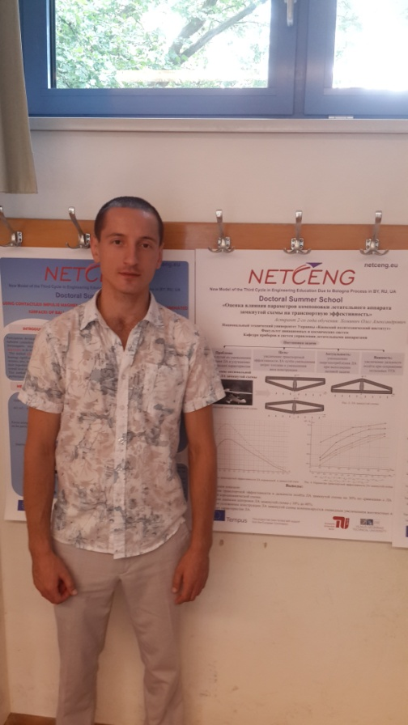
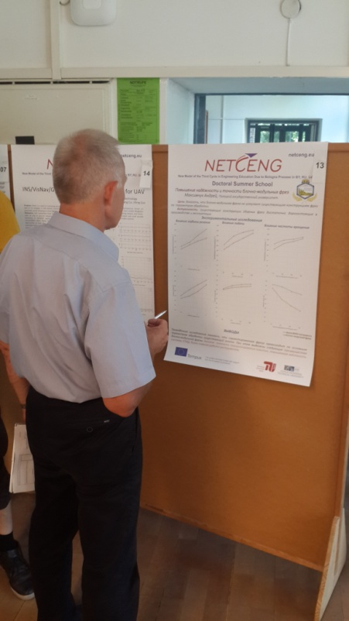
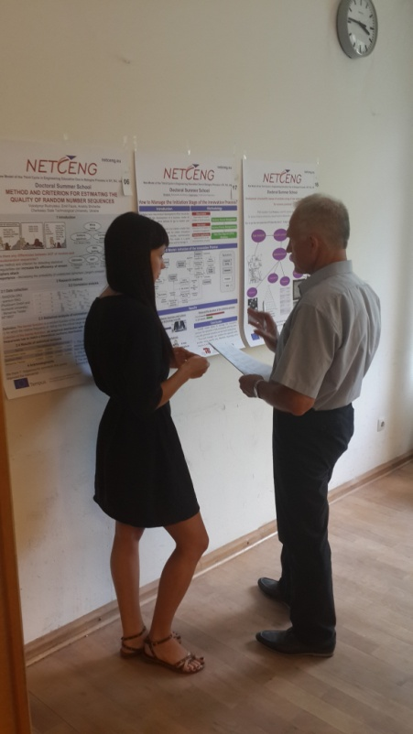
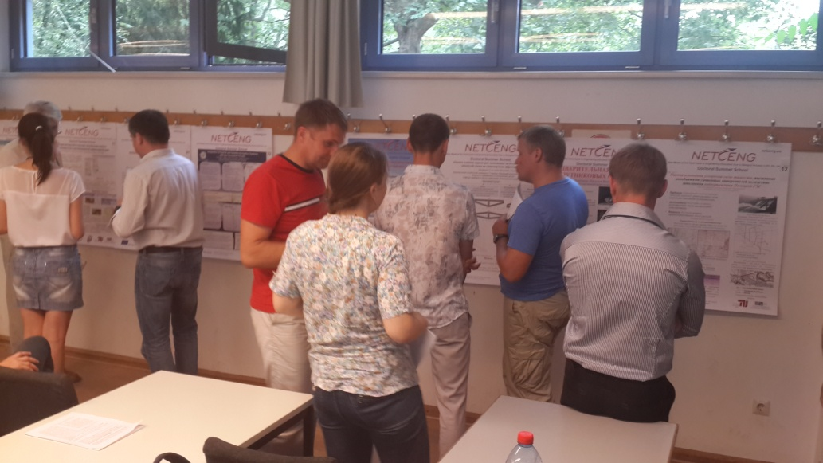
7-8.08.2015 held a poster contest participants and the closing of the summer school
Poster contest

Slide 13
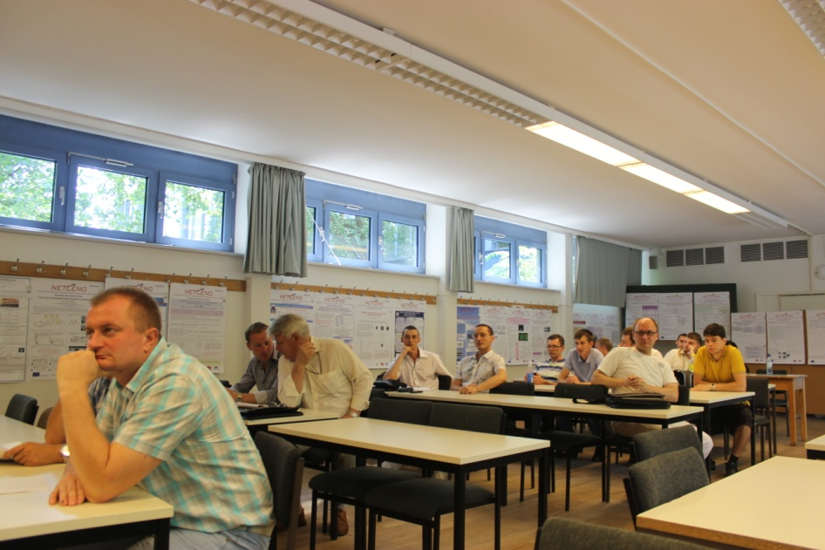
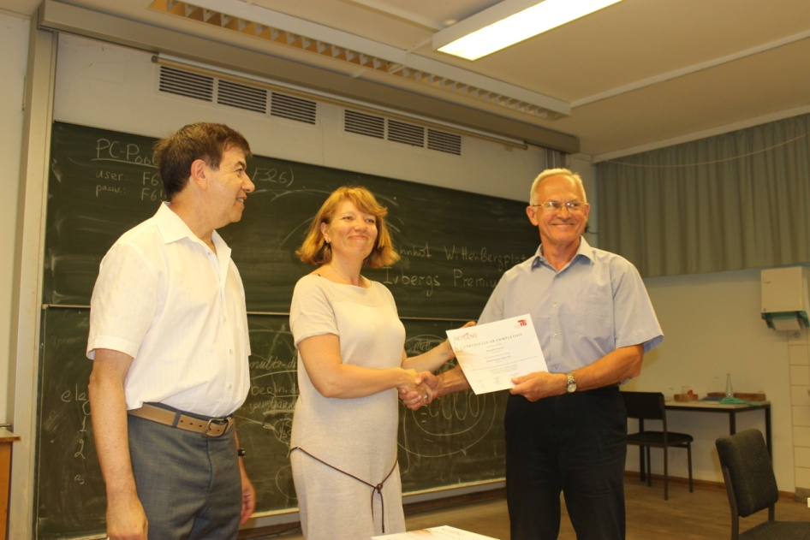
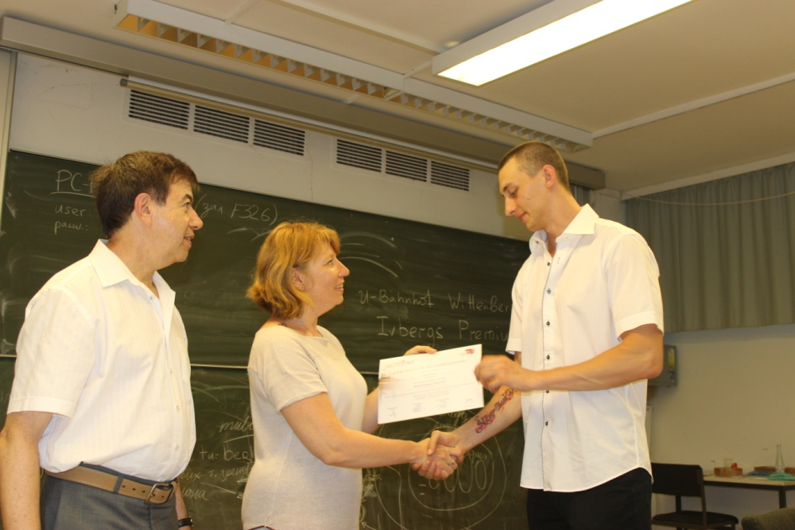
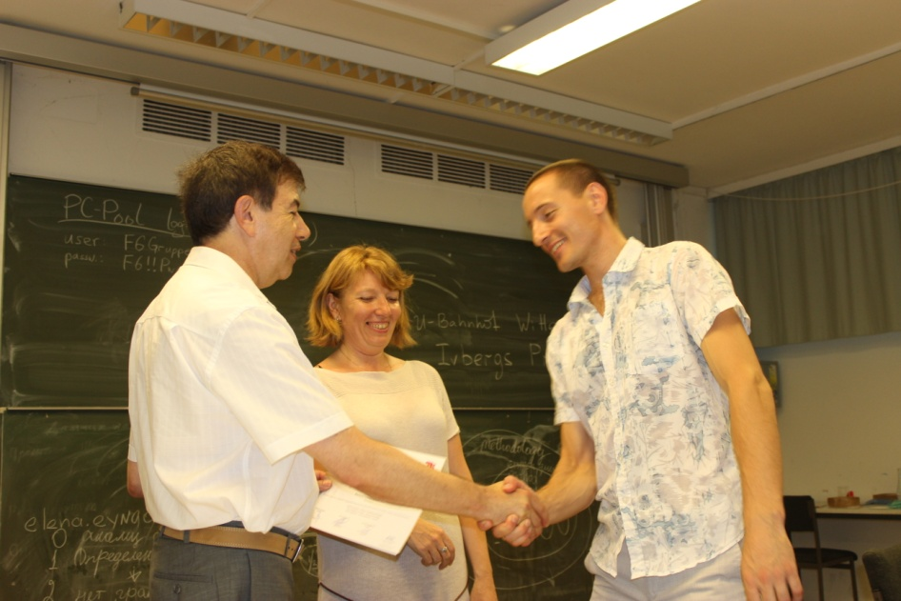
Presentation of certificates to participants of the summer school

Slide 14
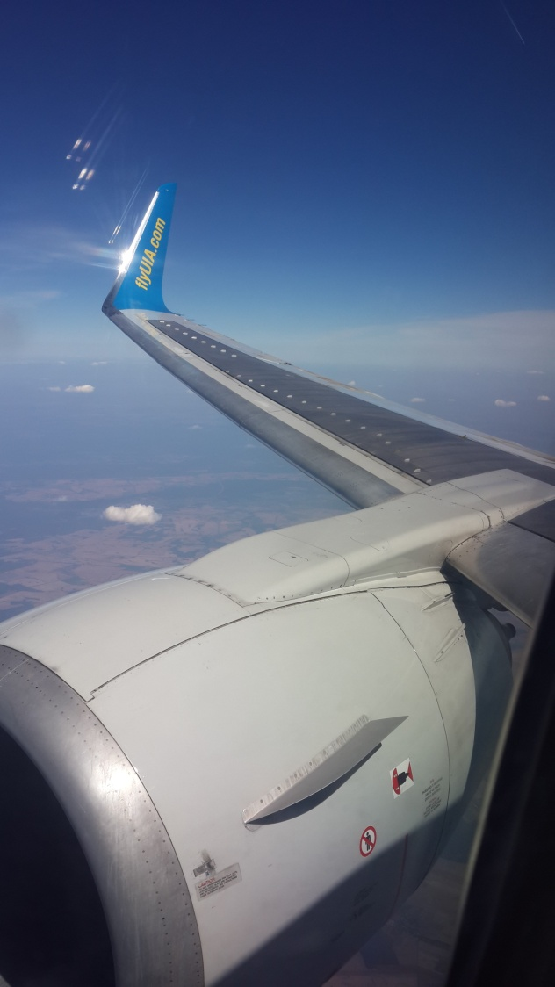
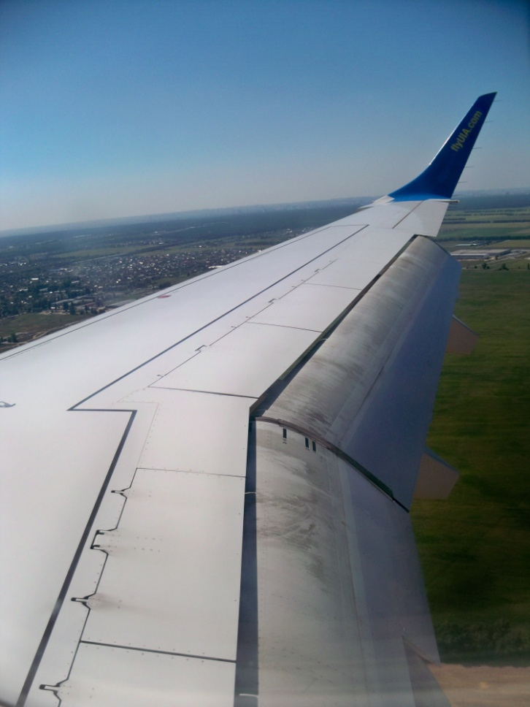
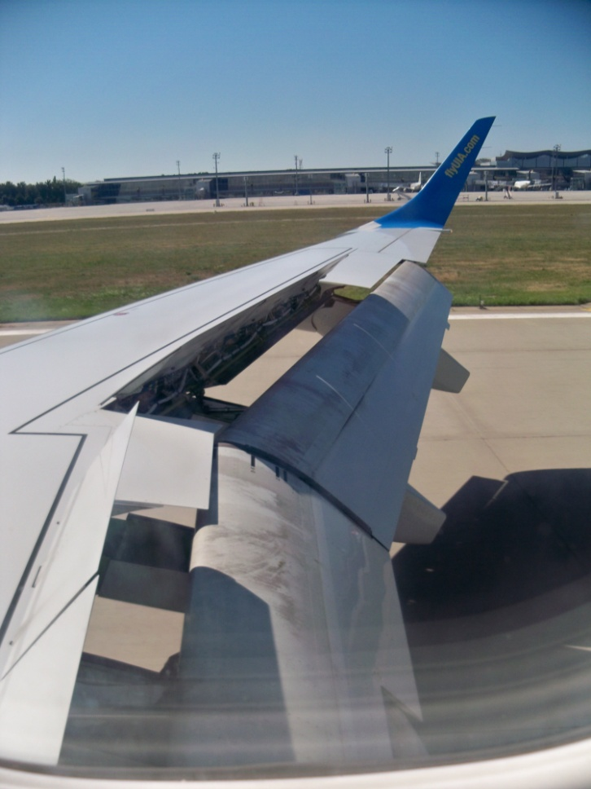
From the porthole window

Slide 15
Upon arrival in Kiev of the summer school participants prepared recommendations for the preparation of MGS journals and ISMM for indexing in the database SCIVERSE SCOPUS.
ALL THE JOURNALS, WHICH SEEKS TO LOG IN, YOU MUST MEET THE FOLLOWING REQUIREMENTS AND HAVE THE:
- A clear editorial policy;
- ISSN - International Standard Serials Number - International Standard Serial Number;
- Unit review articles;
- The international composition of the Editorial Board;
- The international composition of authors;
- Table of Contents Issues in the English language;
- Abstract and keywords in English;
- Bibliography to all, or at least to 80-90% of the articles in issue (only the application is filed with the articles having the bibliography);
- English website;
- Implementation of release schedule in light of (a clear periodicity and regularity of output).

Slide 16
DATA ON THE MAGAZINE FOR THE FORMS OF EXAMINATION, ENTERS THE SYSTEM:
STEP - 1. Basic information about the magazine and its policies:
- Name.
- ISSN.
- Publisher.
- A country.
- Frequency.
- The number of articles per year.
- First Year.
- Language of articles (if not in English, stated the magazine release reasons in another language). - Home page (English).
- Is there pristateynaya bibliography in the Roman alphabet (Latin).
- The level of review.
- Is there an editorial board, the address of its Internet home page (English version), the composition of the editorial board - if there is an international composition (specify country).
- Characteristics of the composition of the authors - whether there is an international structure.
STEP - 2. Presentation of content (presentation of content).
- Examples of articles (pdf-format);
- Home page with the content (the table of contents, author summary, full text, if there are others.);
- Preliminary assessment of the quality of copyright SC's resume.

Slide 17
STEP - 3. Citedness.
- Information on the 3rd to the editors:
- The productivity in terms of publications.
- Citation.
- Hirsch Index.
STEP - 4. Regularuty.
- Information on the existing delays or exit during the next editions of magazines.
- Evaluated on the site.
- It is considered an important indicator ( "may mean the absence of portfolio items, bad management" and others.)
STEP - 5. Accessibility.
- Availability of content on the magazine's website in English.
- Have your home page in English.
- The quality of the site in English.
STEP - 6. Distribution.
- The inclusion in Web of Science.
- The inclusion in the database and any other.
- Availability DOI to CrossRef.
- Availability subscription through WorldCat.

Slide 18
THE SYSTEM IS NOT ACCEPTED JOURNALS :
- Printing is not original articles (translations, information (except for reviews), advertising, etc.);
- Without bibliography or have it in a small number of articles;
- With short, uninformative summary, in bad English;
- Have the production-technical, advertising and information, business orientation, that is, not scientific journals;
- Go irregularly;
- Not having ISSN;
- Without web sites.
MINIMUM SET FORMAL REQUIREMENTS, WITHOUT WHICH THE JOURNAL ACCEPTS NO EXPERTISE (MAGAZINE GETS WAIVER TO EXAMINATION)
- The availability of English-language summary of each scientific article;
- The availability of review of each scientific publication in the journal;
- Compliance with the regular edition release schedule;
- The availability of the ISSN (for printing and / or electronic publication);
- Availability literature lists in the Roman alphabet (Latin).

Slide 19
ALL INFORMATION CONTAINED ON THE ARTICLE, ON DEMAND SYSTEM, SHOULD BE PLACED IN THE JOURNAL TOGETHER (NEAR) WITH ITS FULL TEXT:
- Unit 1 - on the printed language: title of the article; authors); address data authors (institution (s), address of the organization (s), e-mail or all of the author); author's resume; keywords;
- Unit 2 - Information Block 1 in the Roman alphabet (transliteration and translation of the relevant data) in the same sequence: the authors of the Latin alphabet (transliteration); title, abstract, keywords, company name, address of the organization - in English;
- Unit 3 - Full text of the article in the original language;
- Unit 4 - list of literature in Russian (the title "References");
- Unit 5 - a list of references in the Roman alphabet (the title "References").
It is used as another option layouts, when the whole of the English language (the information in the Roman alphabet) is located at the end of the article.

